Slide 1
Database design and Applications CSIZG518/SEZG518/SSZG518)(S1-21)
Uma Maheswari

Slide 2
Session
TOPIC : RA, TRC

Slide 3
LEARNING OUTCOME
Relational algebraic expressions
RA operations
TRC
REFER: T1-Chapter 5
Sections:
6.1- 6.7

Slide 4
QUERY LANGUAGES
QUERY LANGUAGES : A language in which user requests information from the DB.
Categories of languages
procedural
non procedural
“PURE” languages
Relational Algebra
Tuple relational Calculus
Domain Relational Calculus
Pure Languages from underlying basis of query laguages that users uses.

Slide 5
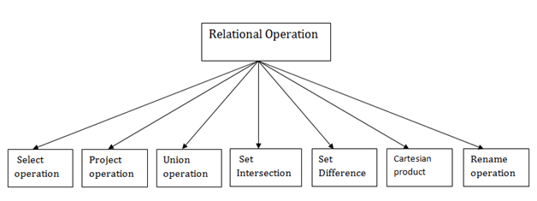
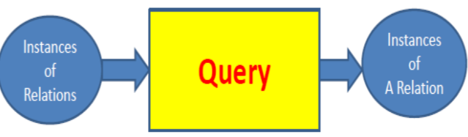
WHY DO WE NEED RA and RA operations?
Relational
Algebra has..

Slide 6
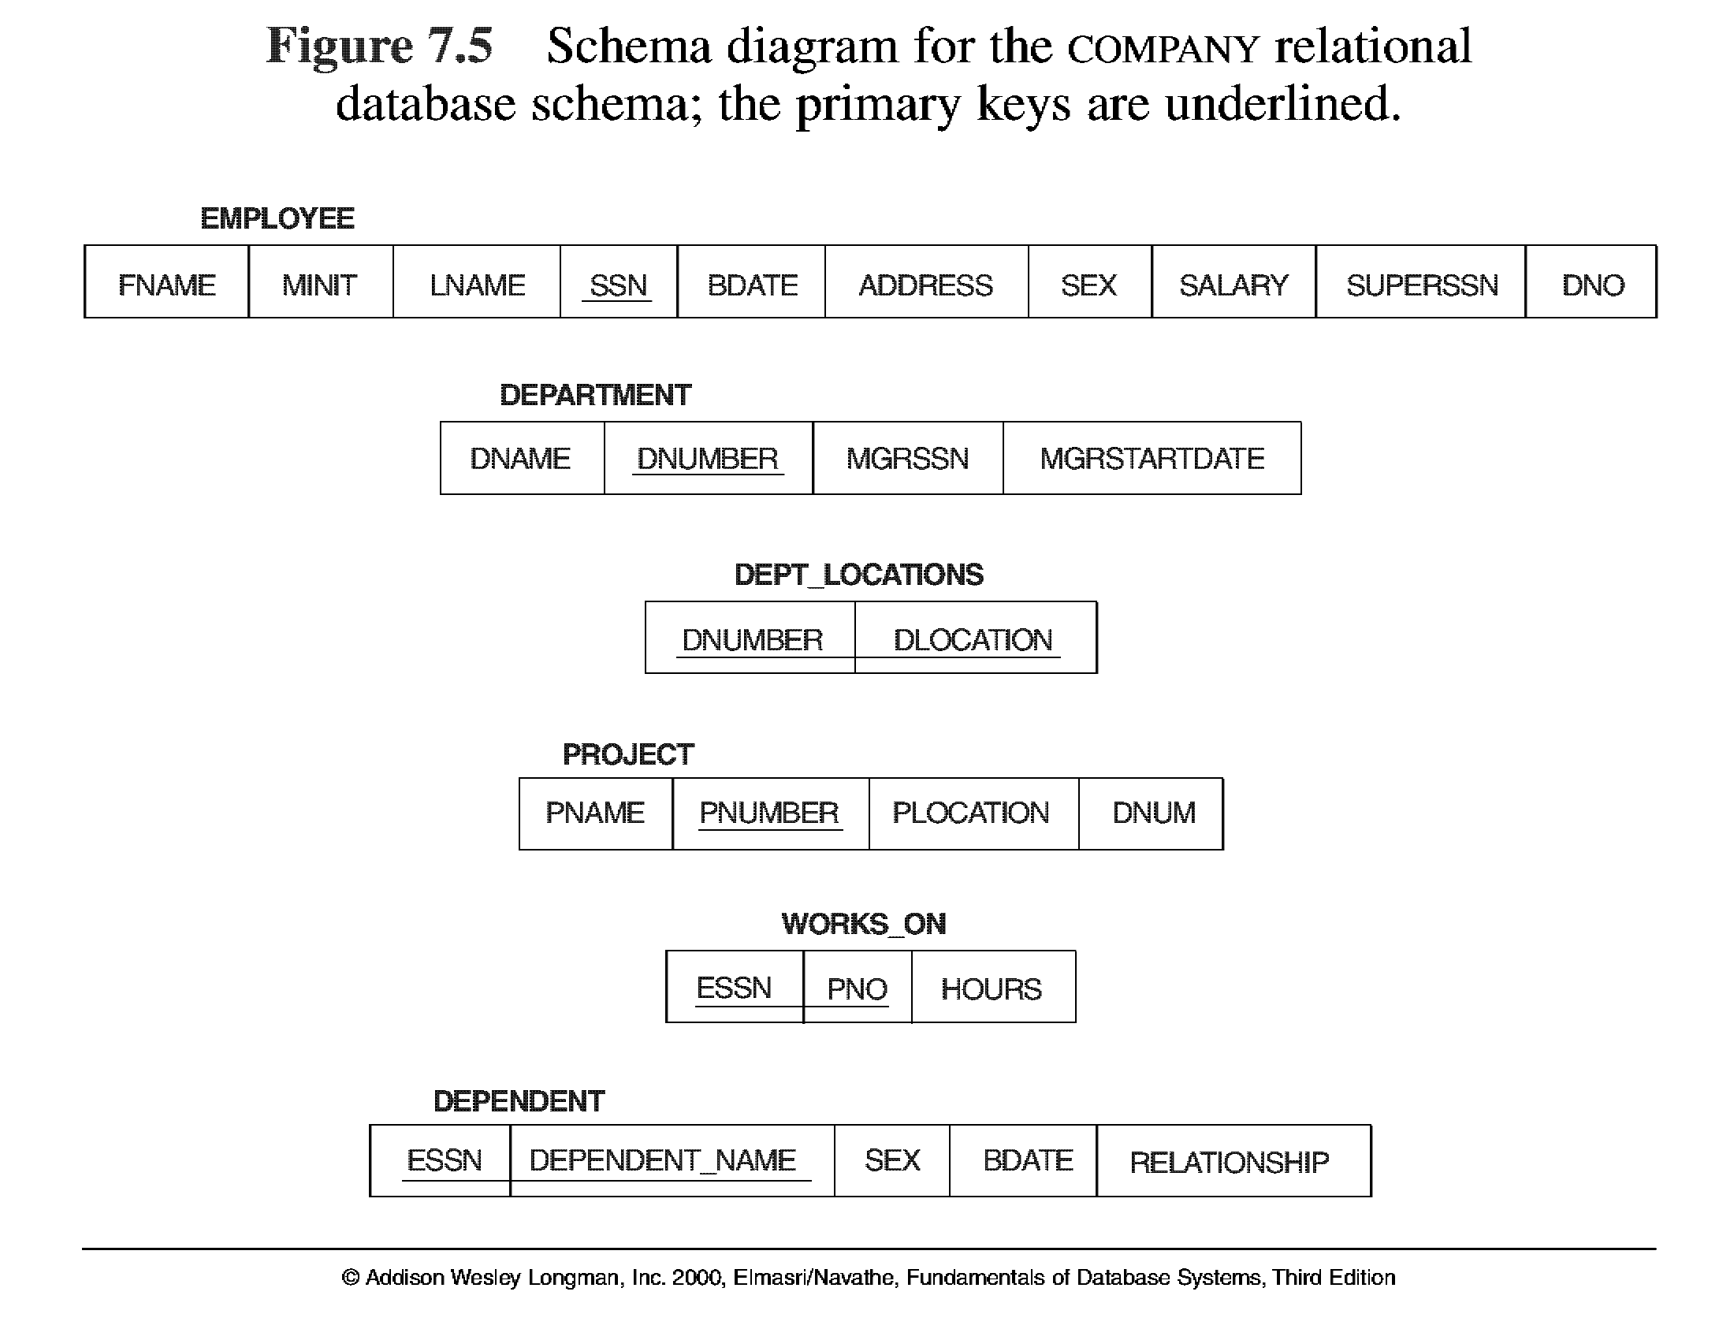
Database State for COMPANY
All examples discussed below refer to the COMPANY database shown here.

Slide 7
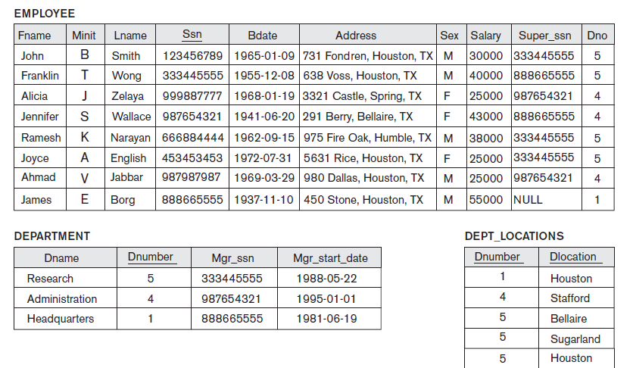
DB INSTANCE

Slide 8
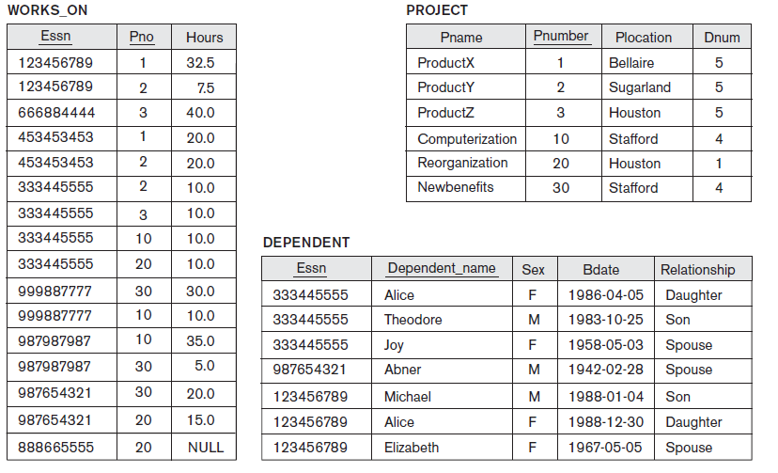
DB INSTANCE

Slide 9
Relational Algebra
The basic set of operations for the relational model is known as the relational algebra. These operations enable a user to specify basic retrieval requests.
The result of a retrieval is a new relation, which may have been formed from one or more relations. The algebra operations thus produce new relations, which can be further manipulated using operations of the same algebra.
A sequence of relational algebra operations forms a relational algebra expression, whose result will also be a relation that represents the result of a database query (or retrieval request).

Slide 10
Unary Relational Operations
SELECT Operation
SELECT operation is used to select a subset of the tuples from a relation that satisfy a selection condition. It is a filter that keeps only those tuples that satisfy a qualifying condition – those satisfying the condition are selected while others are discarded.
Example: To select the EMPLOYEE tuples whose department number is four or those whose salary is greater than $30,000 the following notation is used:
σDNO = 4 (EMPLOYEE)
σSALARY > 30,000 (EMPLOYEE)
In general, the select operation is denoted by _{σ <selection condition>}(R) where the
symbol σ (sigma) is used to denote the select operator, and the selection condition is a Boolean expression specified on the attributes of relation R

Slide 11
Unary Relational Operations
SELECT Operation Properties
The SELECT operation σ _{<selection condition>}(R) produces a relation S that has the same schema as R
The SELECT operation σ is commutative; i.e.,
σ _{<condition1>}(σ _{< condition2>} ( R)) = σ _{<condition2>} (σ _{< condition1>} ( R))
A cascaded SELECT operation may be applied in any order; i.e.,
σ _{<condition1>}(σ _{< condition2>} (σ _{<condition3>} ( R))
= σ _{<condition2>} (σ _{< condition3>} (σ _{< condition1>} ( R)))
A cascaded SELECT operation may be replaced by a single selection with a conjunction of all the conditions; i.e.,
σ _{<condition1>}(σ _{< condition2>} (σ _{<condition3>} ( R))
= σ <condition1> AND < condition2> AND < condition3> ( R)))

Slide 12
Selection

Slide 13
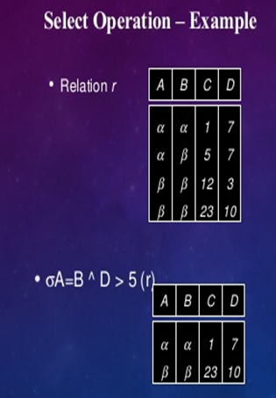
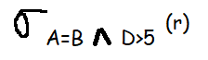
SELECT Operation Properties

Slide 14
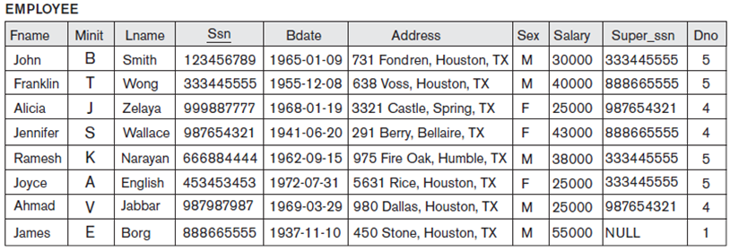
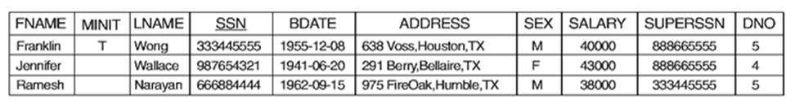
Unary Relational Operations (cont.)

Slide 15
Unary Relational Operations (cont.)
PROJECT Operation
This operation selects certain columns from the table and discards the other columns. The PROJECT creates a vertical partitioning – one with the needed columns (attributes) containing results of the operation and other containing the discarded Columns.
Example: To list each employee’s first and last name and salary, the following is used:
π_{LNAME, FNAME,SALARY}(EMPLOYEE)
The general form of the project operation is π<attribute list>(R) where π (pi) is the symbol used to represent the project operation and <attribute list> is the desired list of attributes from the attributes of relation R.
The project operation removes any duplicate tuples, so the result of the project operation is a set of tuples and hence a valid relation.

Slide 16
Unary Relational Operations (cont.)
PROJECT Operation Properties
The number of tuples in the result of projection π _{<list>} (R)is always less or equal to the number of tuples in R.
If the list of attributes includes a key of R, then the number of tuples is equal to the number of tuples in R.
π _{<list1>} (π _{<list2>} (R) ) = π _{<list1>} (R) as long as <list2> contains the attributes in <list2>

Slide 17
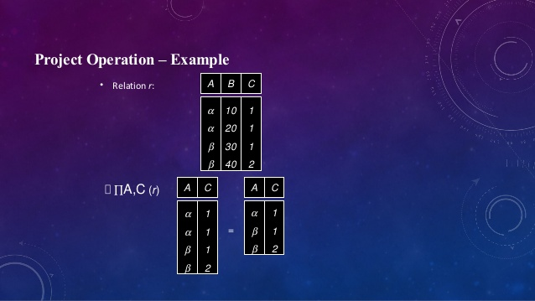
PROJECT Operation Properties

Slide 18
Projection

Slide 19
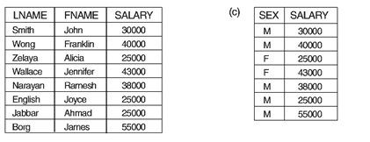
Unary Relational Operations (cont.)

Slide 20
Examples of combined operations.

Slide 21
Relational Algebra Operations From Set Theory
Type Compatibility
The operand relations R₁(A₁, A₂, ..., A_{n}) and R₂(B₁, B₂, ..., B_{n}) must have the same number of attributes, and the domains of corresponding attributes must be compatible; that is, dom(A_{i})=dom(B_{i}) for i=1, 2, ..., n.
UNION ∪, INTERSECTION ∩ and SET DIFFERENCE -.
The resulting relation for R₁∪R₂,R₁ ∩ R₂, or R₁-R₂ has the same attribute names as the first operand relation R1 (by convention).

Slide 22
Relational Algebra Operations From Set Theory
UNION Operation
The result of this operation, denoted by R ∪ S, is a relation that includes all tuples that are either in R or in S or in both R and S. Duplicate tuples are eliminated.
Example: To retrieve the social security numbers of all employees who either work in department 5 or directly supervise an employee who works in department 5, we can use the union operation as follows:
DEP5_EMPS ← σ_{DNO=5} (EMPLOYEE)
RESULT1 ← π _{SSN}(DEP5_EMPS)
RESULT2(SSN) ← π _{SUPERSSN}(DEP5_EMPS)
RESULT ← RESULT1 ∪ RESULT2
The union operation produces the tuples that are in either RESULT1 or RESULT2 or both. The two operands must be “type compatible”.

Slide 23
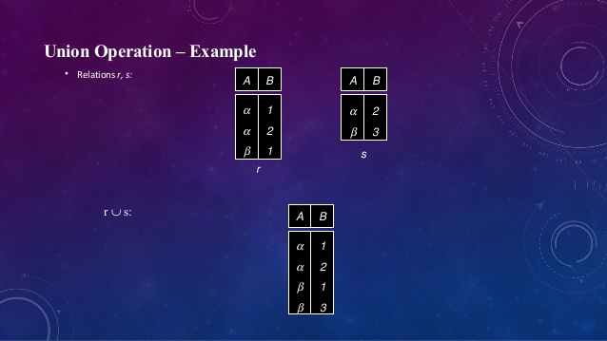
Relational Algebra Operations From Set Theory

Slide 24
UNION

Slide 25
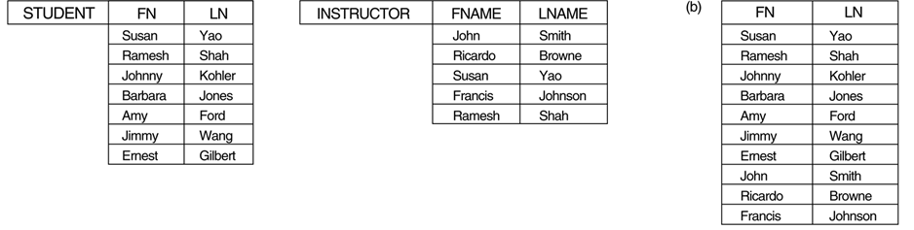
Relational Algebra Operations From Set Theory
UNION Example

Slide 26
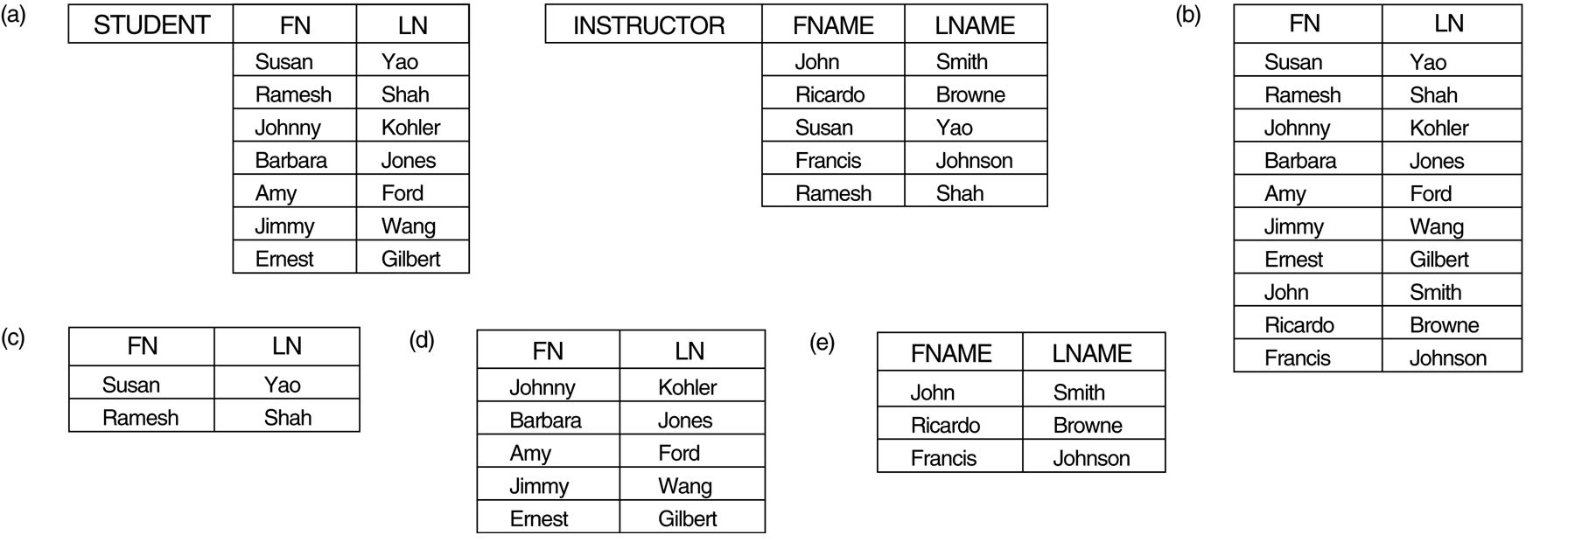
Relational Algebra Operations From Set Theory (cont.)
INTERSECTION OPERATION
The result of this operation, denoted by R ∩ S, is a relation that includes all tuples that are in both R and S. The two operands must be "type compatible"
Example: The result of the intersection operation (figure below) includes only those who are both students and instructors.
STUDENT ∩ INSTRUCTOR

Slide 27
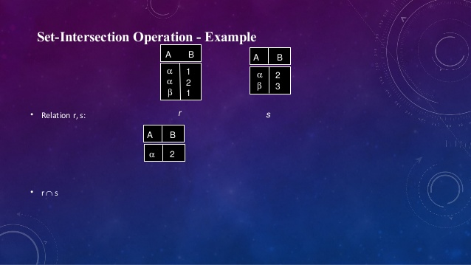
Relational Algebra Operations From Set Theory (cont.)

Slide 28
Intersection

Slide 29
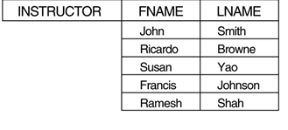
Relational Algebra Operations From Set Theory (cont.)
Set Difference (or MINUS) Operation
The result of this operation, denoted by R - S, is a relation that includes all tuples that are in R but not in S. The two operands must be "type compatible”.
Example: The figure shows the names of students who are not instructors, and the names of instructors who are not students.
STUDENT-INSTRUCTOR
INSTRUCTOR-STUDENT

Slide 30
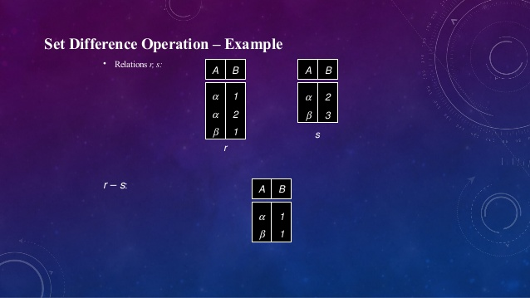
Relational Algebra Operations From Set Theory (cont.)

Slide 32
Relational Algebra Operations From Set Theory (cont.)
Notice that both union and intersection are commutative operations; that is
R ∪ S = S ∪ R, and R ∩ S = S ∩ R
Both union and intersection can be treated as n-ary operations applicable to any number of relations as both are associative operations; that is
R ∪ (S ∪ T) = (R ∪ S) ∪ T, and (R ∩ S) ∩ T = R ∩ (S ∩ T)
The minus operation is not commutative; that is, in general
R - S ≠ S – R

Slide 33
Relational Algebra Operations From Set Theory (cont.)
CARTESIAN (or cross product) Operation
This operation is used to combine tuples from two relations in a combinatorial fashion. In general, the result of R(A₁, A₂, . . ., A_{n}) x S(B₁, B₂, . . ., B_{m}) is a relation Q with degree n + m attributes Q(A₁, A₂, . . ., A_{n}, B₁, B₂, . . ., B_{m}), in that order. The resulting relation Q has one tuple for each combination of tuples—one from R and one from S.
Hence, if R has n_{R} tuples (denoted as |R| = n_{R} ), and S has n_{S} tuples, then
| R x S | will have n_{R} * n_{S} tuples.
The two operands do NOT have to be "type compatible”
Example:
FEMALE_EMPS ← σ _{SEX=’F’}(EMPLOYEE)
EMPNAMES ← π _{FNAME, LNAME, SSN} (FEMALE_EMPS)
EMP_DEPENDENTS ← EMPNAMES x DEPENDENT

Slide 34
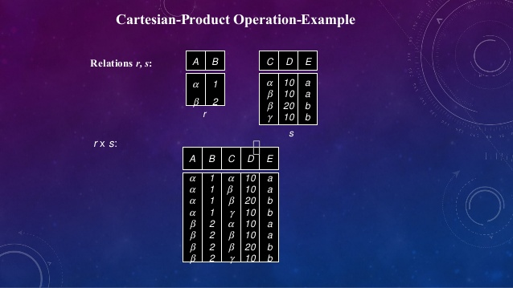
CARTESIAN (or cross product) Operation

Slide 35
Cross Product

Slide 36
CARTESIAN (or cross product) Operation

Slide 37
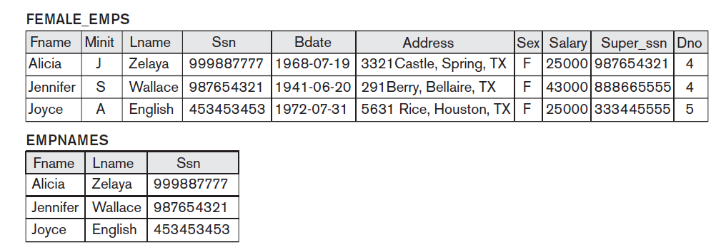
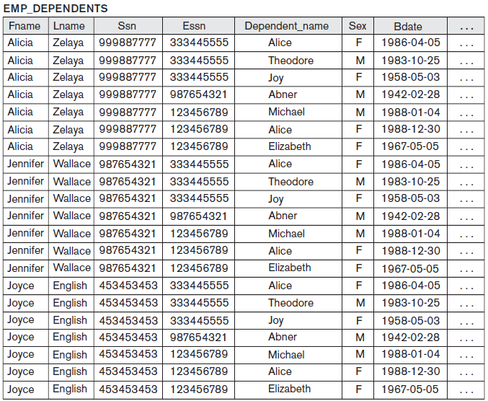
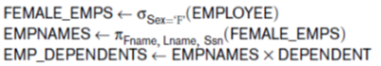
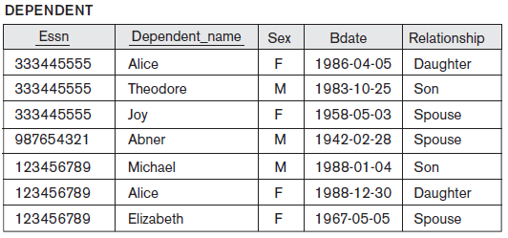
CARTESIAN (or cross product) Operation

Slide 38
Unary Relational Operations (cont.)
Rename Operation
We may want to apply several relational algebra operations one after the other. Either we can write the operations as a single relational algebra expression by nesting the operations, or we can apply one operation at a time and create intermediate result relations. In the latter case, we must give names to the relations that hold the intermediate results.
Example: To retrieve the first name, last name, and salary of all employees who work in department number 5, we must apply a select and a project operation. We can write a single relational algebra expression as follows:
π_{FNAME, LNAME, SALARY}(σ _{DNO=5}(EMPLOYEE))
OR We can explicitly show the sequence of operations, giving a name to each intermediate relation:
DEP5_EMPS ← σ _{DNO=5}(EMPLOYEE)
RESULT ← π _{FNAME, LNAME, SALARY} (DEP5_EMPS)

Slide 39
Unary Relational Operations (cont.)
Rename Operation (cont.)
The rename operator is ρ
The general Rename operation can be expressed by any of the following forms:
ρ _{S (B1, B2, …, Bn )} ( R) is a renamed relation S based on R with column names B₁, B₁, …..B_{n}.
ρ _{S} ( R) is a renamed relation S based on R (which does not specify column ames).
ρ _{(B1, B2, …, Bn )} ( R) is a renamed relation with column names B₁, B₁, …..B_{n} which does not specify a new relation name.

Slide 40
Rename operation

Slide 41
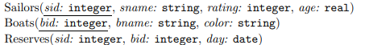
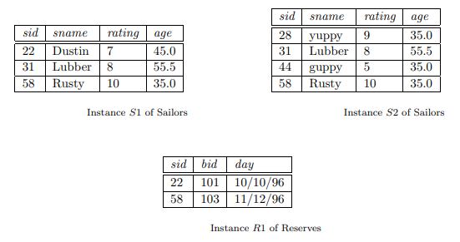
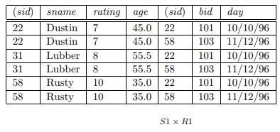
Example

Slide 42
Rename operation
We can use the rename operator to rename STUDENT relation to STUDENT1.
ρ(STUDENT1, STUDENT)

Slide 43
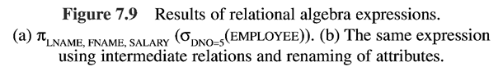
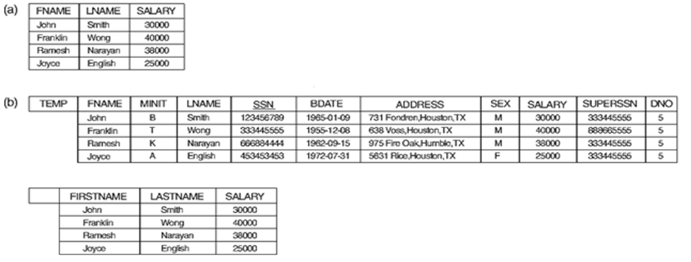
Unary Relational Operations (cont.)

Slide 44
Binary Relational Operations
JOIN Operation
The sequence of cartesian product followed by select is used quite commonly to identify and select related tuples from two relations, a special operation, called JOIN. It is denoted by a
This operation is very important for any relational database with more than a single relation, because it allows us to process relationships among relations.
The general form of a join operation on two relations R(A₁, A₂, . . ., A_{n}) and S(B₁, B₂, . . ., B_{m}) is:
R _{<join condition>}S
where R and S can be any relations that result from general relational algebra expressions.

Slide 45
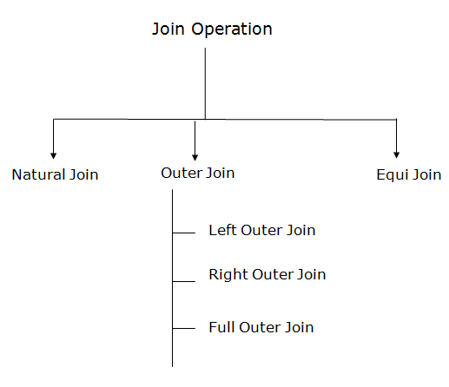
Join

Slide 46
Conditional Join
EMPLOYEE
EMP_CODE | EMP_NAME
101 | Stephan
102 | Jack
103 | Harry
SALARY
EMP_CODE | SALARY
101 | 50000
102 | 30000
103 | 25000
(EMPLOYEE ⋈ SALARY)
EMP_CODE | EMP_NAME | SALARY
101 | Stephan | 50000
102 | Jack | 30000
103 | Harry | 25000

Slide 47
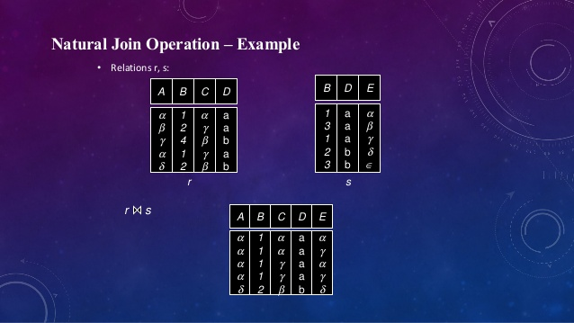
Natural Join
A natural join is the set of tuples of all combinations in R and S that are equal on their common attribute names.
Notes:
Compares one row from r with all rows of s so here (alpha,1,alpha,a) of r with all rows of s here it matches (1,a,alpha) and (1,a,gamma)
Similarly (beta,2,gamma,a) is not matched with any rows in S ……

Slide 48
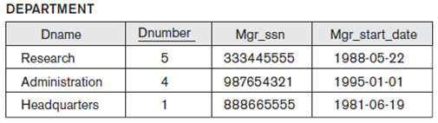
Natural Join

Slide 49

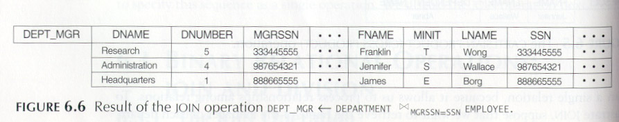
Binary Relational Operations (cont.)
Example: Suppose that we want to retrieve the name of the manager of each department. To get the manager’s name, we need to combine each DEPARTMENT tuple with the EMPLOYEE tuple whose SSN value matches the MGRSSN value in the department tuple. We do this by using the join operation.
DEPT_MGR ← DEPARTMENT _{MGRSSN=SSN} EMPLOYEE

Slide 50
Binary Relational Operations (cont.)
EQUIJOIN Operation
The most common use of join involves join conditions with equality comparisons only. Such a join, where the only comparison operator used is =, is called an EQUIJOIN. In the result of an EQUIJOIN we always have one or more pairs of attributes (whose names need not be identical) that have identical values in every tuple.
The JOIN seen in the previous example was EQUIJOIN.
NATURAL JOIN Operation
Because one of each pair of attributes with identical values is superfluous, a new operation called natural join—denoted by *—was created to get rid of the second (superfluous) attribute in an EQUIJOIN condition.
The standard definition of natural join requires that the two join attributes, or each pair of corresponding join attributes, have the same name in both relations. If this is not the case, a renaming operation is applied first.

Slide 52
Equi Join

Slide 53



Slide 54
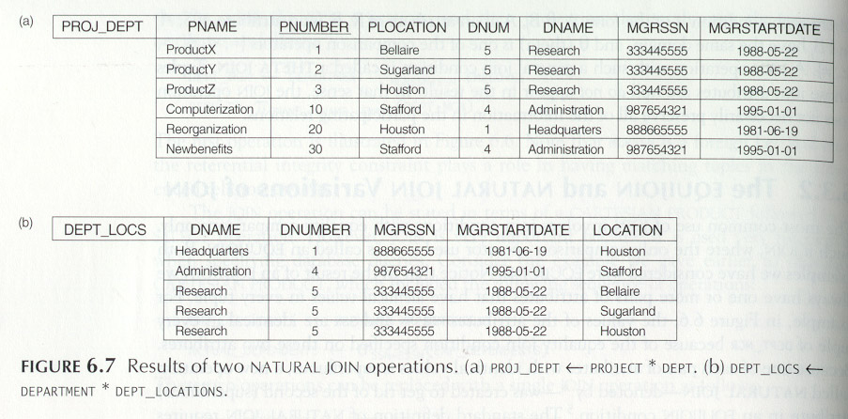
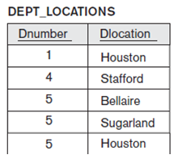
Binary Relational Operations (cont.)
Example: To apply a natural join on the DNUMBER attributes of DEPARTMENT and DEPT_LOCATIONS, it is sufficient to write:
DEPT_LOCS ← DEPARTMENT * DEPT_LOCATIONS

Slide 55
Binary Relational Operations (cont.)
A general join condition is of the form
<condition> AND <condition> AND...AND <condition>
where each <condition> is of the form Ai θ Bj, Ai is an attribute of R, Bj is an attribute of S, Ai and Bj have the same domain, and θ (theta) is one of the comparison operators {=, <, ≤, >, ≥, ≠}.
A JOIN operation with such a general join condition is called a THETA JOIN. Tuples whose join attributes are NULL or for which the join condition is FALSE do not appear in the result. In that sense, the JOIN operation does not necessarily preserve all of the information in the participating relations, because tuples that do not get combined with matching ones in the other relation do not appear in the result.

Slide 56
Complete Set of Relational Operations
The set of operations including select σ, project π , union ∪, set difference - , and cartesian product X is called a complete set because any other relational algebra expression can be expressed by a combination of these five operations.
For example:
R ∩ S = (R ∪ S ) – ((R − S) ∪ (S − R))
R _{<join condition>}S = σ _{<join condition>} (R X S)

Slide 57
Binary Relational Operations (cont.)
DIVISION Operation
The division operation is applied to two relations
R(Z) ÷ S(X), where X subset Z. Let Y = Z - X (and hence Z = X ∪ Y); that is, let Y be the set of attributes of R that are not attributes of S.
The result of DIVISION is a relation T(Y) that includes a tuple t if tuples t_{R} appear in R with t_{R} [Y] = t, and with
t_{R} [X] = t_{s} for every tuple t_{s} in S.
For a tuple t to appear in the result T of the DIVISION, the values in t must appear in R in combination with every tuple in S.

Slide 58
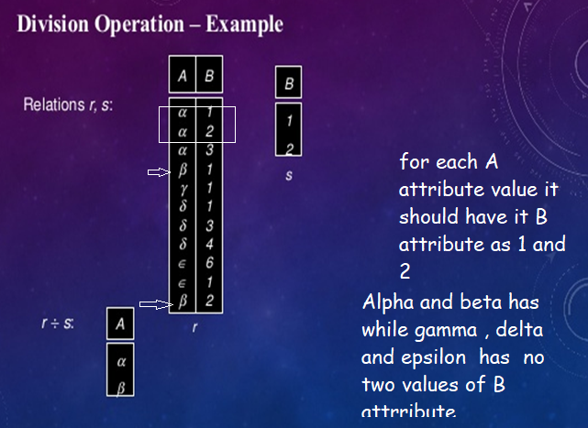
Notes:
Ie., S’s 2 rows should be having same A ‘s or common A value here alpha has 1 and 2 in r so we consider alpha in result.
Simlarly we have beta which has 1 and 2 in B so we consider beta in result
As for del it has 1,3,4 therefore doesn’t match with 1 and 2 of s. therefore del ignored in the result
As for epsilon it has 1,6 which not again matched.. Epsilon is ignored.

Slide 59
Division

Slide 60
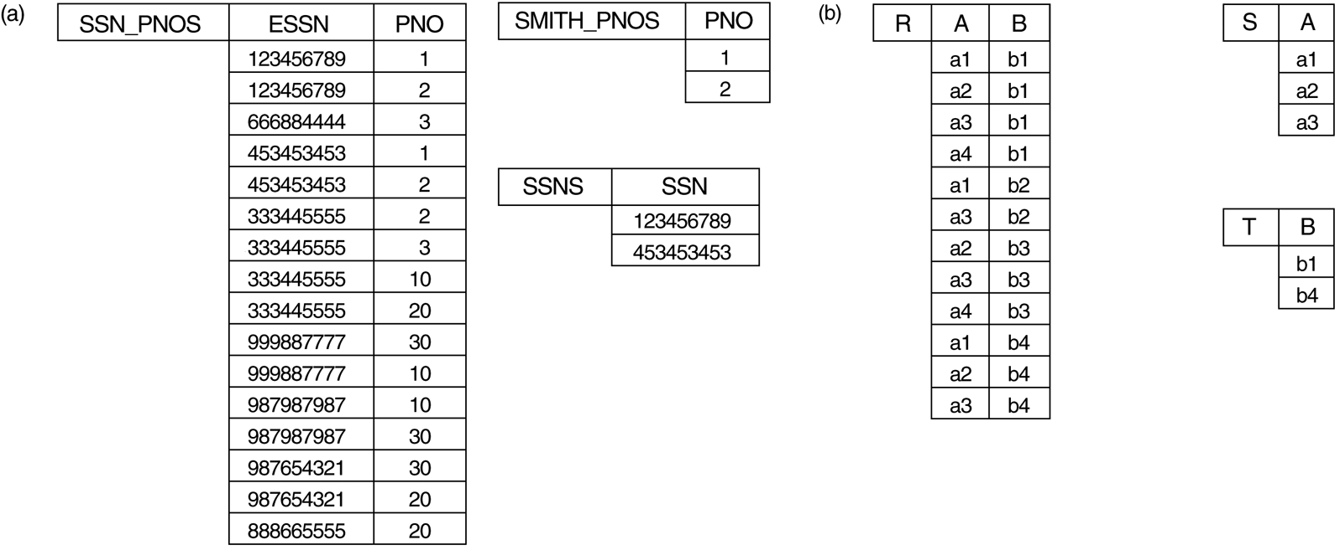
Binary Relational Operations (cont.)

Slide 62
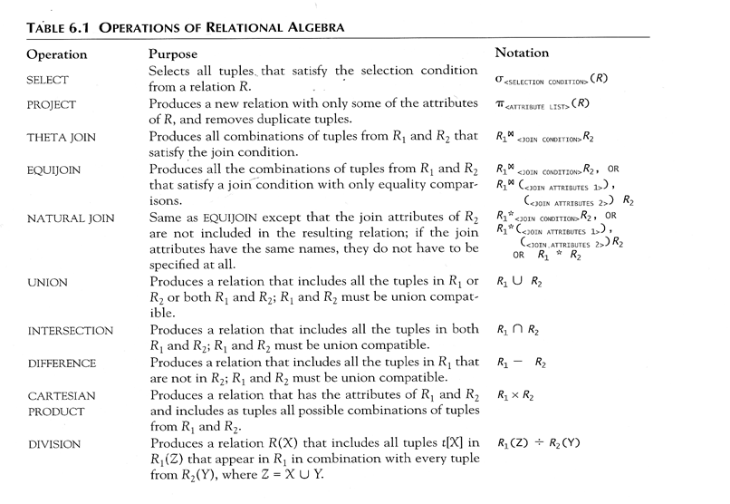
Recap of Relational Algebra Operations

Slide 63
Additional Relational Operations
Aggregate Functions and Grouping
A type of request that cannot be expressed in the basic relational algebra is to specify mathematical aggregate functions on collections of values from the database.
Examples of such functions include retrieving the average or total salary of all employees or the total number of employee tuples. These functions are used in simple statistical queries that summarize information from the database tuples.
Common functions applied to collections of numeric values include SUM, AVERAGE, MAXIMUM, and MINIMUM. The COUNT function is used for counting tuples or values.

Slide 64
Aggregate Functions and Grouping
We can define an AGGREGATE FUNCTION operation, using the symbol ℑ (pronounced
script F), to specify these types of requests as follows:
<grouping attributes> ℑ<function list> (R)
where <grouping attributes> is a list of attributes of the relation specified in R, and
<function list> is a list of (<function> <attribute>) pairs. In each such pair,
<function> is one of the allowed functions—such as SUM, AVERAGE, MAXIMUM,
MINIMUM,COUNT—and <attribute> is an attribute of the relation specified by R.

Slide 65
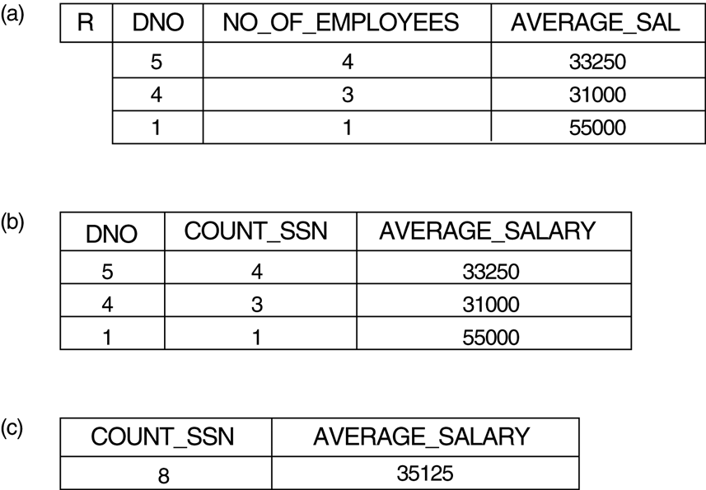
Additional Relational Operations (cont.)
ρR(Dno, No_of_employees, Average_sal)(Dno ℑ COUNT Ssn, AVERAGE Salary (EMPLOYEE))
Dno ℑ COUNT Ssn, AVERAGE Salary(EMPLOYEE).
ℑ COUNT Ssn, AVERAGE Salary(EMPLOYEE).

Slide 66
Additional Relational Operations (cont.)
Use of the Functional operator ℱ
ℱ_{MAX Salary} (Employee) retrieves the maximum salary value from the Employee relation
ℱ_{MIN Salary} (Employee) retrieves the minimum Salary value from the Employee relation
ℱ_{SUM Salary} (Employee) retrieves the sum of the Salary from the Employee relation
_{DNO} ℱ_{COUNT SSN, AVERAGE Salary} (Employee) groups employees by DNO (department number) and computes the count of employees and average salary per department.[ Note: count just counts the number of rows, without removing duplicates]

Slide 67
Additional Relational Operations (cont.)
Recursive Closure Operations
Another type of operation that, in general, cannot be specified in the basic original relational algebra is recursive closure. This operation is applied to a recursive relationship.
An example of a recursive operation is to retrieve all SUPERVISEES of an EMPLOYEE e at all levels—that is, all EMPLOYEE e’ directly supervised by e; all employees e’’ directly supervised by each employee e’; all employees e’’’ directly supervised by each employee e’’; and so on .
Although it is possible to retrieve employees at each level and then take their union, we cannot, in general, specify a query such as “retrieve the supervisees of ‘James Borg’ at all levels” without utilizing a looping mechanism.
The SQL3 standard includes syntax for recursive closure.

Slide 68
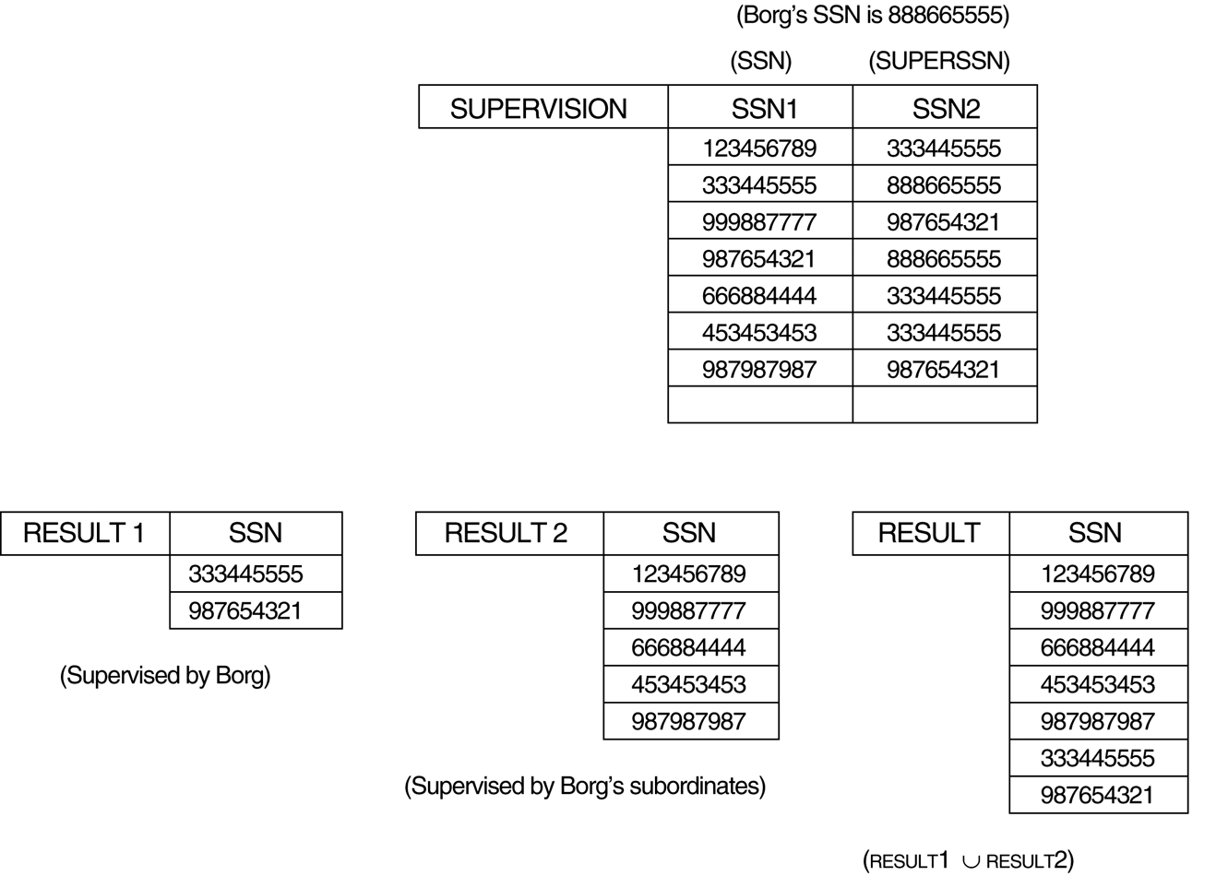
Additional Relational Operations (cont.)
Notes:
Find Bongs SSN 888665555 matching SSN1 it gives result1
then from result1 SSN is again matched in supervision in the SSN2 col where it matches you get result2
Now result1 U result2

Slide 69


Additional Relational Operations (cont.)
The OUTER JOIN Operation
In NATURAL JOIN tuples without a matching (or related) tuple are eliminated from the join result. Tuples with null in the join attributes are also eliminated. This amounts to loss of information.
A set of operations, called outer joins, can be used when we want to keep all the tuples in R, or all those in S, or all those in both relations in the result of the join, regardless of whether or not they have matching tuples in the other relation.
The left outer join operation keeps every tuple in the first or left relation R in R S; if no matching tuple is found in S, then the attributes of S in the join result are filled or “padded” with null values.
A similar operation, right outer join, keeps every tuple in the second or right relation S in the result of R S.
A third operation, full outer join, denoted by keeps all tuples in both the left and the right relations when no matching tuples are found, padding them with null values as needed.

Slide 70
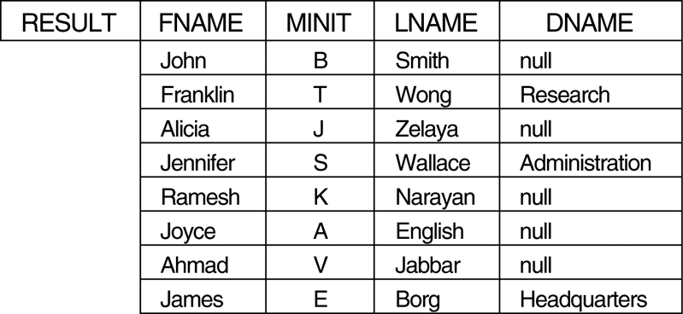
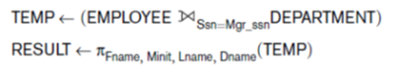
Additional Relational Operations (cont.)
The LEFT OUTER JOIN operation keeps every tuple in the first, or left, relation R in R S; if no matching tuple is found in S, then the attributes of S in the join result are filled or padded with NULL values.
Figure 6.12
The result of a LEFT
OUTER JOIN operation.
What if employee has only first 3 tuples ?

Slide 71
Additional Relational Operations (cont.)
RIGHT OUTER JOIN, denoted by , keeps every tuple in the
second, or right, relation S in the result of R S.
A third operation, FULL OUTER JOIN, denoted by , keeps all tuples in both the left and the right relations when no matching tuples are found, padding them with NULL values as needed.

Slide 72
Additional Relational Operations (cont.)
OUTER UNION Operations
The outer union operation was developed to take the union of tuples from two relations if the relations are not union compatible.
R_S(X,Y,Z)
This operation will take the union of tuples in two relations R(X, Y) and S(X, Z) that are partially compatible, meaning that only some of their attributes, say X, are union compatible.
The attributes that are union compatible are represented only once in the result, and those attributes that are not union compatible from either relation are also kept in the result relation T(X, Y, Z).
Example: An outer union can be applied to two relations whose schemas are STUDENT(Name, SSN, Department, Advisor) and INSTRUCTOR(Name, SSN, Department, Rank). Tuples from the two relations are matched based on having the same combination of values of the shared attributes—Name, SSN, Department. If a student is also an instructor, both Advisor and Rank will have a value; otherwise, one of these two attributes will be null.
The result relation STUDENT_OR_INSTRUCTOR will have the following attributes:
STUDENT_OR_INSTRUCTOR (Name, SSN, Department, Advisor, Rank)

Slide 73
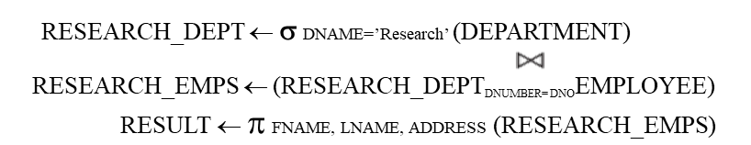
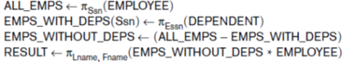
Examples of Queries in Relational Algebra
Q1: Retrieve the name and address of all employees who work for the ‘Research’ department.
(or)
Q6: Retrieve the names of employees who have no dependents.
Notes:
We first retrieve a relation with all employee Ssns in ALL_EMPS. Then we create a
table with the Ssns of employees who have at least one dependent in
EMPS_WITH_DEPS. Then we apply the SET DIFFERENCE operation to retrieve
employees Ssns with no dependents in EMPS_WITHOUT_DEPS, and finally join this
with EMPLOYEE to retrieve the desired attributes. As a single in-line expression, this
query becomes:

Slide 74
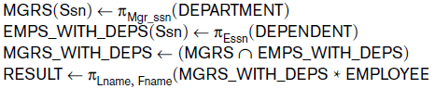
Examples of Queries in Relational Algebra
Query 7. List the names of managers who have at least one dependent.
we retrieve the Ssns of managers in MGRS, and the Ssns of employees
with at least one dependent in EMPS_WITH_DEPS, then we apply the SET
INTERSECTION operation to get the Ssns of managers who have at least one
dependent.

Slide 75
Examples

Slide 78
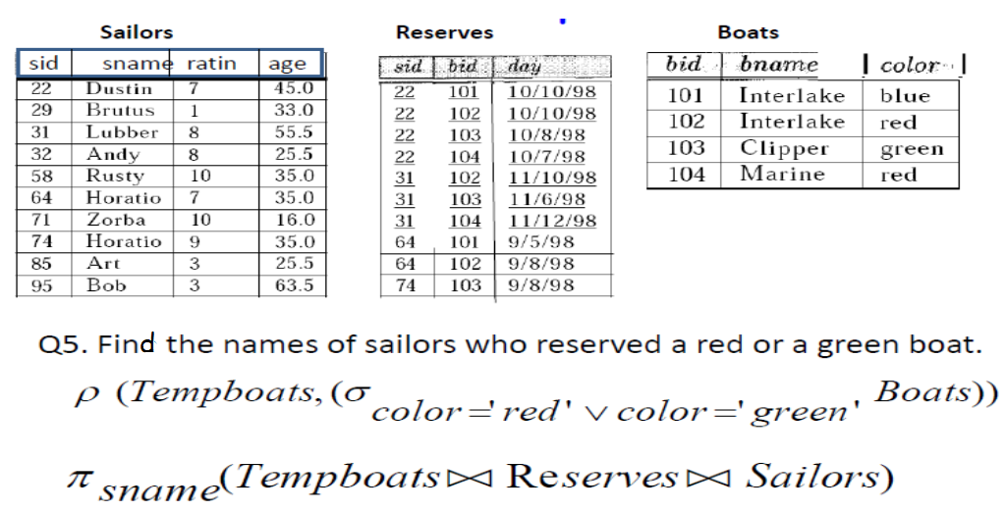

Slide 79
Relational Calculus
A relational calculus expression creates a new relation, which is specified in terms of variables that range over rows of the stored database relations (in tuple calculus) or over columns of the stored relations (in domain calculus).
In a calculus expression, there is no order of operations to specify how to retrieve the query result—a calculus expression specifies only what information the result should contain. This is the main distinguishing feature between relational algebra and relational calculus.
Relational calculus is considered to be a nonprocedural language. This differs from relational algebra, where we must write a sequence of operations to specify a retrieval request; hence relational algebra can be considered as a procedural way of stating a query.

Slide 80
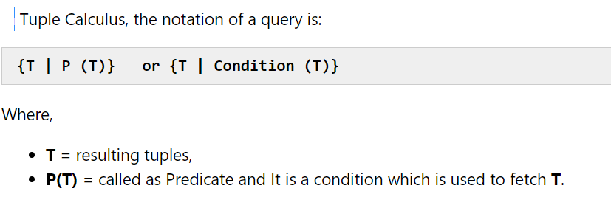
Tuple relational calculus

Slide 81
Tuple Relational Calculus
The tuple relational calculus is based on specifying a number of tuple variables. Each tuple variable usually ranges over a particular database relation, meaning that the variable may take as its value any individual tuple from that relation.
A simple tuple relational calculus query is of the form
{t | COND(t)}
where t is a tuple variable and COND (t) is a conditional expression involving t. The result of such a query is the set of all tuples t that satisfy COND (t).
Example: To find the first and last names of all employees whose salary is above $50,000, we can write the following tuple calculus expression:
{t.FNAME, t.LNAME | EMPLOYEE(t) AND t.SALARY>50000}
The condition EMPLOYEE(t) specifies that the range relation of tuple variable t is EMPLOYEE. The first and last name (PROJECTION π_{FNAME, LNAME}) of each EMPLOYEE tuple t that satisfies the condition t.SALARY>50000 (SELECTION σ _{SALARY >50000}) will be retrieved.
Notes:
The condition EMPLOYEE(t) specifies that the range relation of tuple variable t is
EMPLOYEE. Each EMPLOYEE tuple t that satisfies the condition t.Salary>50000 will
be retrieved. Notice that t.Salary references attribute Salary of tuple variable t;

Slide 82
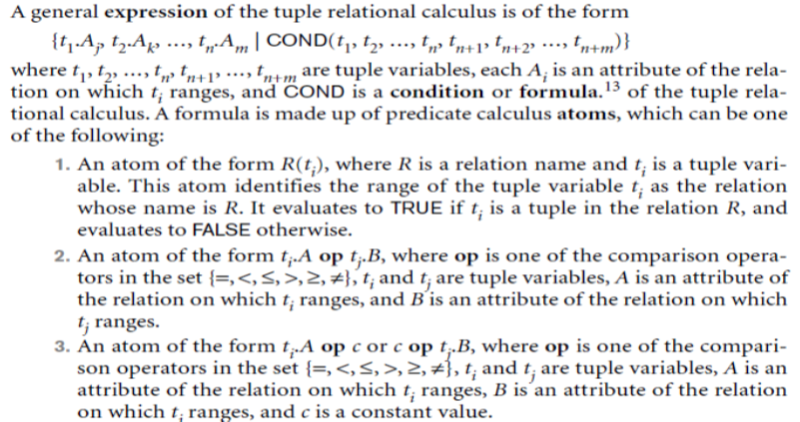
TUPLE CALCULUS

Slide 83
EXAMPLE TUPLE CALCULUS
Query 0. Retrieve the birth date and address of the employee (or employees)
whose name is John B. Smith.
Q0: {t.Bdate, t.Address | EMPLOYEE(t) AND t.Fname=‘John’ AND t.Minit=‘B’
AND t.Lname=‘Smith’}

Slide 84
The Existential and Universal Quantifiers
Two special symbols called quantifiers can appear in formulas; these are the universal quantifier (∀) and the existential quantifier (∃).
Informally, a tuple variable t is bound if it is quantified, meaning that it appears in an (∀ t) or (∃ t) clause; otherwise, it is free.
If F is a formula, then so is (∃ t)(F), where t is a tuple variable. The formula (∃ t)(F) is true if the formula F evaluates to true for some (at least one) tuple assigned to free occurrences of t in F; otherwise (∃ t)(F) is false.
If F is a formula, then so is (∀ t)(F), where t is a tuple variable. The formula (∀ t)(F) is true if the formula F evaluates to true for every tuple (in the universe) assigned to free occurrences of t in F; otherwise (∀ t)(F) is false.
It is called the universal or “for all” quantifier because every tuple in “the universe of” tuples must make F true to make the quantified formula true.
Notes:
"For all x, P(x) holds" or "for every x, P(x) holds". is called the universal quantifier, and x means all the objects x in the universe where atomic formula is P(x).
Vx P(x) is equivalent to the conjunction: P(x₁)) and P(x₂) and P(x₃) ... And P(x_{n}) .

Slide 85
The Existential and Universal Quantifiers
The expression: x P(x), denotes the universal quantification of the atomic formula P(x).
Translated into the English language, the expression is understood as:
"For all x, P(x) holds" or "for every x, P(x) holds". is called the universal quantifier, and
x means all the objects x in the universe.
If all the elements in the universe of discourse can be listed then the universal quantification
x P(x) is equivalent to the conjunction: P(x₁)) and P(x₂) and P(x₃) ... and P(x_{n}) .
Eg., if we knew that there were only 4 cars in our universe of discourse (c1, c2, c3 and c4) then we
could also translate the statement as: P(c1) and P(c2) and P(c3) and P(c4)
The expression: x P(x), denotes the existential quantification of P(x). Translated as:
"There exists an x such that P(x)" or "There is at least one x such that P(x)" is called the existential quantifier , and x means at least one object x in the universe. If this is followed by P(x) then the meaning is that P(x) is true for at least one object x of the universe.
existential quantification xP(x) is equivalent to the disjunction: P(x₁) OR P(x₂) OR P(x₃) ... OR P(x_{n}).
Eg, there were only 5 living creatures in our universe of discourse (say: me, he, she, rex and fluff),
then we could also write the statement as: P(me) OR P(he) OR P(she) OR P(rex) OR P(fluff)

Slide 86
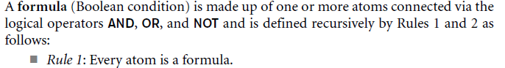
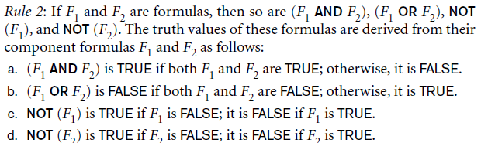
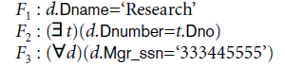
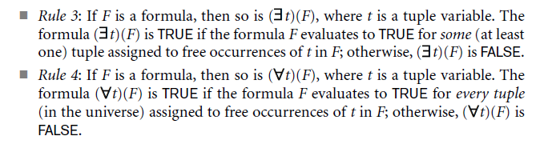
The Existential and Universal Quantifiers
An occurrence of a tuple variable t is free or bound in a formula made up of logical connectives—(F1 AND F2), (F1 OR F2), NOT(F1), and NOT(F)— depending on whether it is free or bound in F1 or F2 (if it occurs in either).
Consider eg:
The tuple variable d is free in both F1 and F2, whereas it is bound to the quantifier
in F3. Variable t is bound to the ( ) quantifier in F2.

Slide 87
Example: TRC
Loan number | Branch name | Amount
L33 | ABC | 10000
L35 | DEF | 15000
L49 | GHI | 9000
L98 | DEF | 65000
Find the loan number for each loan of an amount greater or equal to 10000.
{t| ∃ s ∈ loan(t[loan number] = s[loan number] ∧ s[amount]>=10000)}
Loan number
L33
L35
L98
Depositor
Borrower
Customer name | Account number
Saurabh | 1111
Mehak | 1113
Sumiti | 1114
Customer name | Loan number
Saurabh | L33
Mehak | L49
Ria | L98
Find the loan number, branch, amount of loans of greater than or equal to 10000 amount.
{t| t ∈ loan ∧ t[amount]>=10000}
Find the names of all customers who have a loan and an account at the bank.
Loan number | Branch name | Amount
L33 | ABC | 10000
L35 | DEF | 15000
L98 | DEF | 65000
{t | ∃ s ∈ borrower( t[customer-name] = s[customer-name]) ∧ ∃ u ∈ depositor( t[customer-name] = u[customer-name])}
Customer name
Saurabh
Mehak

Slide 88
Example: TRC
Engineer
Company
Incentive + Bonus
Engineer Name | Address | City
Raghav | A23/B6 | Mumbai
Sameer | 567/453 | Delhi
Sujata | 543/27 | Kanpur
Shivani | D35 | Jaipur
Amar | B82/78 | Kolkata
Company | City
Wipro | Chennai
Accenture | Delhi
Infosys | Bangalore
Company | Incentive + Bonus
Wipro | 4,000
Accenture | 5,000
Infosys | 7,000
Salary (Included Incentive + Bonus
Engineer Name | Company | Salary
Raghav | Wipro | 28,000
Sameer | Infosys | 30,000
Sujata | Accenture | 30,000
Shivani | Wipro | 31,000
Amar | Accenture | 35,000
Salary
Engineer Name | Company | Salary
Raghav | Wipro | 24,000
Sameer | Infosys | 23,000
Sujata | Accenture | 25,000
Shivani | Wipro | 27,000
Amar | Accenture | 30,000
Find the Engineer Name, Company and Salary of those whose salaries are greater than 23,000 excluded Incentive + Bonus.
Engineer Name | Company | Salary
Raghav | Wipro | 24,000
Sujata | Accenture | 25,000
Shivani | Wipro | 27,000
Amar | Accenture | 30,000
{T| T ∈ Salary ∧ T [Salary]>= 23,000}
T [Salary] is called as Tuple variable.

Slide 89
TRC tutorials
Consider :
Book(accno, yrPub, title)
User(card#, bname,baddr)
Supplier(sname, saddr)
Borrow(accno,card#,DOI)
Supplied(accno,sname,price, DOI)
Get all books published in year 1991
To get only accno and title from qn1
Find the names of all suppliers who have the same address as “Narosa”.

Slide 90





Example Query Using Existential Quantifier

Slide 91










Example Query Using Universal Quantifier

Slide 92

Example Query Using Universal Quantifier
Find the names of employees who work on all the projects controlled by department number 5.
Query :
{e.LNAME, e.FNAME | EMPLOYEE(e) and ( (∀ x)(not(PROJECT(x)) or not(x.DNUM=5)
OR ( (∃ w)(WORKS_ON(w) and w.ESSN=e.SSN and x.PNUMBER=w.PNO) ) ) )}
Exclude from the universal quantification all tuples that we are not interested in by making the condition true for all such tuples. The first tuples to exclude (by making them evaluate automatically to true) are those that are not in the relation R of interest.
In query above, using the expression not(PROJECT(x)) inside the universally quantified formula evaluates to true all tuples x that are not in the PROJECT relation. Then we exclude the tuples we are not interested in from R itself.
The expression not(x.DNUM=5) evaluates to true all tuples x that are in the project relation but are not controlled by department 5.
Finally, we specify a condition that must hold on all the remaining tuples in R.
( (∃ w)(WORKS_ON(w) and w.ESSN=e.SSN and x.PNUMBER=w.PNO)

Slide 93
Languages Based on Tuple Relational Calculus
The language SQL is based on tuple calculus. It uses the basic
SELECT <list of attributes>
FROM <list of relations>
WHERE <conditions>
block structure to express the queries in tuple calculus where the SELECT clause mentions the attributes being projected, the FROM clause mentions the relations needed in the query, and the WHERE clause mentions the selection as well as the join conditions.
SQL syntax is expanded further to accommodate other operations. (See Chapter 8).
Another language which is based on tuple calculus is QUEL which actually uses the range variables as in tuple calculus.
Its syntax includes:
RANGE OF <variable name> IS <relation name>
Then it uses
RETRIEVE <list of attributes from range variables>
WHERE <conditions>
This language was proposed in the relational DBMS INGRES.

Slide 94




Tutorial Session RA
(Q1) Find the names of sailors who have reserved boat 103. This query can be written as follows:

Slide 95



Tutorial Session

Slide 96




Tutorial Session
this solution is incorrect—it instead tries to compute sailors who have reserved a boat that is both red and green. (Since bid is a key for Boats, a boat can be only one color; this query will always return an empty answer set.)

Slide 97



Tutorial Session
To find sailors who have reserved red or green boats (Query Q5); just replace ∩ by ∪

Slide 98

Tutorial Session

Slide 99

Tutorial Session TRC

Slide 100



Tutorial Session

Slide 101
THANK YOU

